Slide 1
Chapter 1: Introduction

Slide 2
Content
What Operating Systems Do?
Computer-System Organization
Computer-System Architecture
Operating-System Structure
Operating-System Operations
Protection and Security
Process Management
Memory Management
Storage Management
Types of Operating Systems
Computing Environments
Objectives
To describe the basic organization of computer systems
To provide a grand tour of the major components of operating systems
To give an overview of the many types of computing environments
To explore several open-source operating systems

Slide 3
1. WHAT OPERATING SYSTEMS DO
The operating system controls the hardware and coordinates its use among the various application programs for the various users.
We can also view a computer system as consisting of hardware, software, and data.
The operating system provides the means for proper use of these resources in the operation of the computer system.
An operating system is similar to a government. Like a government, it performs no useful function by itself. It simply provides an environment within which other programs can do useful work.
To understand more fully the operating system's role, we explore operating systems from two viewpoints:
  The user
  The system.

Slide 4
User View
The user's view of the computer varies according to the interface being used
Single user computers (e.g., PC, workstations). Such systems are designed for one user to monopolize its resources. The goal is to maximize the work (or play) that the user is performing. the operating system is designed mostly for ease of use and good performance.
Multi user computers (e.g., mainframes, computing servers). These users share resources and may exchange information. The operating system in such cases is designed to maximize resource utilization -- to assure that all available CPU time, memory, and I/O are used efficiently and that no individual users takes more than their air share.

Slide 5
Handheld computers (e.g., smartphones and tablets). The user interface for mobile computers generally features a touch screen. The systems are resource poor, optimized for usability and battery life.
Embedded computers (e.g., computers in home devices and automobiles) The user interface may have numeric keypads and may turn indicator lights on or off to show status. The operating systems are designed primarily to run without user intervention.

Slide 6
System View
From the computer's point of view, the operating system is the program most intimately involved with the hardware. There are two different views:
The operating system is a resource allocator
  Manages all resources
  Decides between conflicting requests for efficient and fair resource use
The operating systems is a control program
  Controls execution of programs to prevent errors and improper use of the computer

Slide 7
What is an Operating System
A program that acts as an intermediary between a user of a computer and the computer hardware
Operating system goals:
  Execute user programs and make solving user problems easier
  Make the computer system convenient to use
  Use the computer hardware in an efficient manner

Slide 8
Computer System Structure
Computer system can be divided into four components:
  Hardware – provides basic computing resources
    CPU, memory, I/O devices
  Operating system
    Controls and coordinates use of hardware among various applications and users
  Application programs – define the ways in which the system resources are used to solve the computing problems of the users
    Word processors, compilers, web browsers, database systems, video games
  Users
    People, machines, other computers

Slide 9
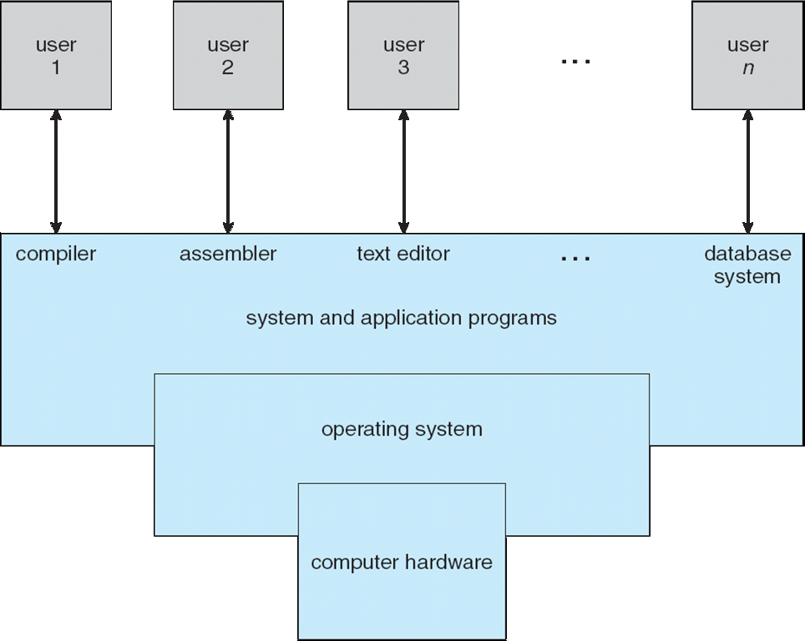
Four Components of a Computer System

Slide 10
Operating System Definition
No universally accepted definition
“Everything a vendor ships when you order an operating system ” is good approximation
  But varies wildly
“The one program running at all times on the computer ” is the kernel. Everything else is either a system program (ships with the operating system) or an application program.

Slide 11
2. COMPUTER-SYSTEM ORGANIZATION
Computer Startup
Bootstrap program is loaded at power-up or reboot
  Typically stored in ROM or EPROM, generally known as firmware
  Initializes all aspects of system
  Loads operating system kernel and starts execution

Slide 12
Computer System Operation
Once the kernel is loaded and executing, it can start providing services to the system and its users.
Some services are provided outside of the kernel, by system programs that are loaded into memory at boot time to become system processes, or system daemons that run the entire time the kernel is running.
On UNIX, the first system process is init and it starts many other daemons. Once this phase is complete, the system is fully booted, and the system waits for some event to occur.
The occurrence of an event is usually signaled by an interrupt.

Slide 13
3. COMPUTER-SYSTEM ARCHITECTURE
Single general-purpose processor
  Most systems have special-purpose processors as well
Multiprocessors systems growing in use and importance
  Also known as parallel systems, tightly-coupled systems
  Advantages include:
    Increased throughput – more processors, less time needed to complete tasks
    Economy of scale – multiprocessor cost less than multiple single processor because they share peripherals, storage and power supplies
    Increased reliability – functions can be distributed properly among several processors, if one fails, the system will not halt (stop). Graceful-degradation (the ability to continue providing service proportional to the level of surviving hardware) / fault-tolerance (suffer a failure of one component but can still continue operation).

Slide 14
Single general-purpose processor
  Most systems have special-purpose processors as well
Multiprocessors systems growing in use and importance
  Also known as parallel systems, tightly-coupled systems
  Two types:
    Symmetric Multiprocessing – each processor performs all tasks
    Asymmetric Multiprocessing – each processor is assigned a specific task.

Slide 15
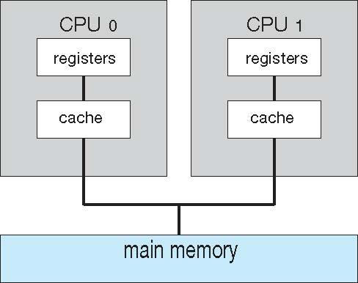
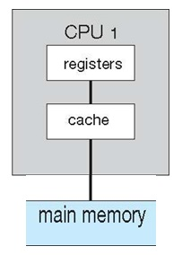
Symmetric Multiprocessing Architecture
Multiprocessors
Single processors
Multiple single processors

Slide 16
Multicore Systems
Most CPU design now includes multiple computing cores on a single chip. Such multiprocessor systems are termed multicore.
Multicore systems can be more efficient than multiple chips with single cores because:
  On-chip communication is faster than between-chip communication.
  One chip with multiple cores uses significantly less power than multiple single-core chips, an important issue for laptops as well as mobile devices.
Note -- while multicore systems are multiprocessor systems, not all multiprocessor systems are multicore.

Slide 17
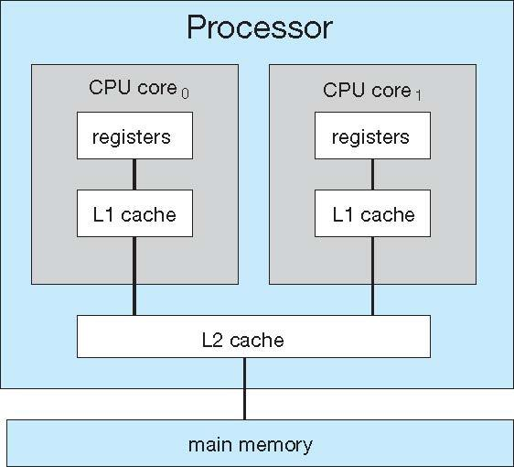
A dual-core with two cores placed on the same chip
Multiprocessors

Slide 18
A multiprocessors system contains more than one CPU, its allowing then to work in parallel.
A multicore CPU has multiple execution cores on one CPU meaning that a certain subset of the CPU’s components is duplicated, so that multiple cores can work in parallel on separate operations.
  E.g. a multicore processor has separate L1 cache and execution unit for each core while is shares L2 cache for the entire processor
A simultaneous multithreading (hyper-threading) is where an even smaller subset of a processor’s or core’s components is duplicated:
  E.g. hyper-threading have duplicate thread scheduling resources, so that the core looks like two separate processors to the OS, even though it only has one set of execution units.

Slide 19
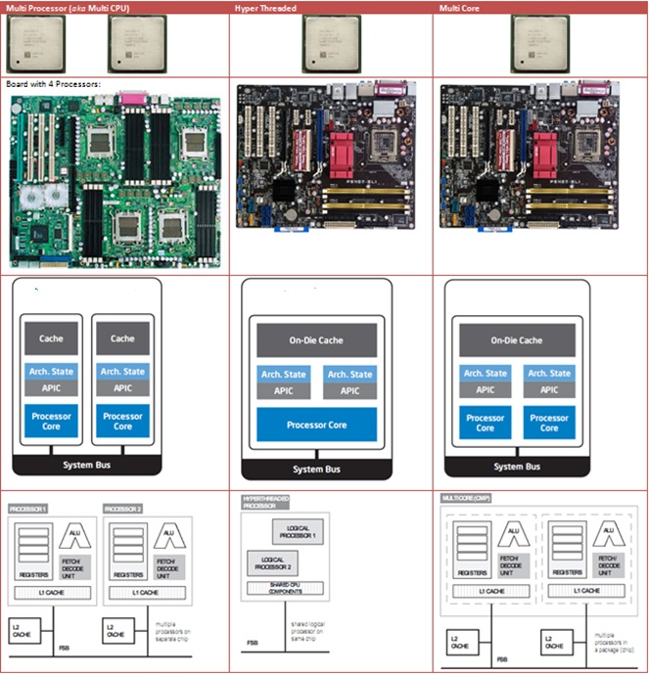


Slide 20
Clustered Systems
Like multiprocessor systems, but multiple systems working together
Usually sharing storage via a storage-area network (SAN)
Provides a high-availability service which survives failures
  Asymmetric clustering has one machine in hot-standby (master) mode while the others run applications (slaves). The hot-standby machine only monitor the active server.
  Symmetric clustering has multiple nodes/machines running applications, monitoring each other
Some clusters are for high-performance computing (HPC)
  Applications must be written to use parallelization
Some have distributed lock manager (DLM) to avoid conflicting operations

Slide 21
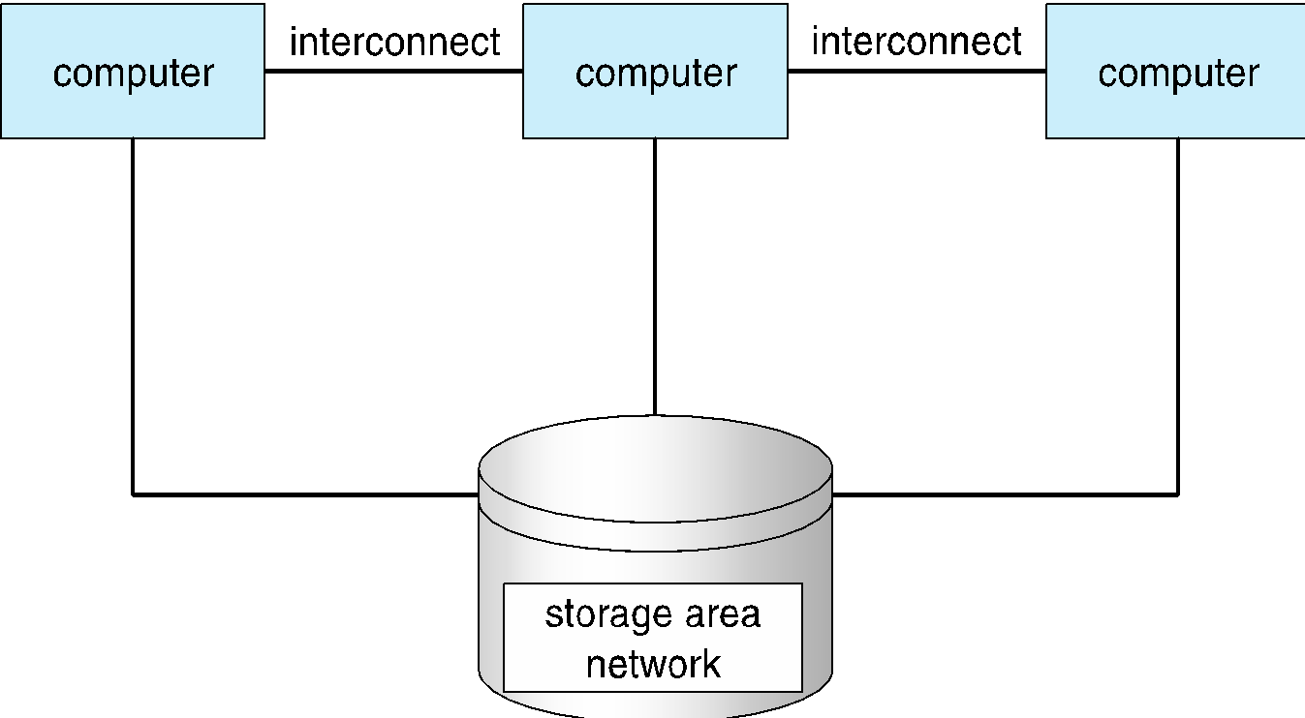
General structure of a clustered system

Slide 22
4. OPERATING-SYSTEM STRUCTURE
Single user cannot keep CPU and I/O devices busy at all times
Multiprogramming organizes jobs (code and data) so CPU always has one to execute
A subset of total jobs in system is kept in memory
Batch systems:
  One job selected and run via job scheduling
  When it has to wait (for I/O for example), OS switches to another job
Timesharing systems:
  Logical extension of batch systems -- CPU switches jobs so frequently that users can interact with each job while it is running, creating interactive computing

Slide 23
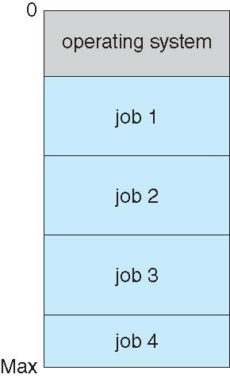
Memory Layout for Multiprogrammed System

Slide 24
Timesharing Systems
Timesharing is also referred to as multitasking.
Response time should be < 1 second
Each user has at least one program executing in memory. Such a program is referred to as a process
If several processes are ready to run at the same time, we need to have CPU scheduling.
If processes do not fit in memory, swapping moves them in and out to run
Virtual memory allows execution of processes not completely in memory

Slide 25
5. OPERATING-SYSTEM OPERATIONS
A mechanism that allows the OS to protect itself and other system components
Two modes of operations:
  User mode
  Kernel mode
Mode bit (0 or 1) provided by hardware
  Provides ability to distinguish when system is running user code or kernel code
  Some instructions designated as privileged, only executable in kernel mode
  Systems call by a user asking the OS to perform some function changes from user mode to kernel mode.
  Return from a system call resets the mode to user mode.

Slide 26

Transition from User to Kernel Mode

Slide 27
Hardware Protection
Privileged instructions can be issued only in kernel mode.
Examples of privileged instruction
  I/O instruction, Halt, changing execution mode
  Instruction to modify the content of memory management registers and timer
  Instruction to switch interrupt services to on/off
Besides using Dual Mode to protect the hardware by having privileged instruction, other types of hardware protections are:
  I/O protection
  Memory protection
  CPU protection
  Kernel mode

Slide 28
Timer
To prevent process to be in infinite loop (process hogging resources), a timer is used, which is a hardware device.
Timer is a counter that is decremented by the physical clock.
Timer is set to interrupt the computer after some time period
Operating system sets the counter (privileged instruction)
When counter reaches the value zero, and interrupt is generated.
The OS sets up the value of the counter before scheduling a process to regain control or terminate program that exceeds allotted time

Slide 29
6. PROTECTION AND SECURITY
Protection – A mechanism for controlling access of processes (or users) to resources defined by the OS
Security – A defense of the system against internal and external attacks
  Huge range, including denial-of-service, worms, viruses, identity theft, theft of service
Systems generally first distinguish among users, to determine who can do what
  User identities (user IDs, security IDs) include name and associated number, one per user
  User ID is associated with all files and processes of that user to determine access control
  Group identifier (group ID) allows set of users to be defined and controls managed, then also associated with each process, file
  Privilege escalation allows user to change to effective ID with more rights

Slide 30
7. PROCESS MANAGEMENT
A process is a program in execution. It is a unit of work within the system. Program is a passive entity, process is an active entity.
Process needs resources to accomplish its task
  CPU, memory, I/O, files
  Initialization data
Process termination requires reclaim of any reusable resources
Single-threaded process has one program counter specifying location of next instruction to execute
  Process executes instructions sequentially, one at a time, until completion
Multi-threaded process has one program counter per thread
Typically system has many processes, some user, some operating system running concurrently on one or more CPUs
  Concurrency by multiplexing the CPUs among the processes / threads

Slide 31
Process Management Activities
The operating system is responsible for the following activities in connection with process management:
Creating and deleting both user and system processes
Suspending and resuming processes
Providing mechanisms for process synchronization
Providing mechanisms for process communication
Providing mechanisms for deadlock handling

Slide 32
8. Memory Management
All data in memory before and after processing
All instructions in memory in order to execute
Memory management determines what is in memory when
  Optimizing CPU utilization and computer response to users
Memory management activities
  Keeping track of which parts of memory are currently being used and by whom
  Deciding which processes (or parts thereof) and data to move into and out of memory
  Allocating and deallocating memory space as needed

Slide 33
9. STORAGE MANAGEMENT
OS provides uniform, logical view of information storage
  Abstracts physical properties to logical storage unit - file
  Each medium is controlled by device (i.e., disk drive, tape drive)
    Varying properties include access speed, capacity, data-transfer rate, access method (sequential or random)
File-System Management
  Files usually organized into directories
  Access control on most systems to determine who can access what
  OS activities include
    Creating and deleting files and directories
    Primitives to manipulate files and dirs
    Mapping files onto secondary storage
    Backup files onto stable (non-volatile) storage media

Slide 34
Mass Storage Management
  Usually disks used to store data that does not fit in main memory or data that must be kept for a “long” period of time
  Most programs, use the disk as both the source
  and destination of their processing
  Due to this proper management is importance to a computer system
  OS activities in connection with disk management
    Free-space management
    Storage allocation
    Disk scheduling
Some storage need not be fast
  Tertiary storage includes optical storage, magnetic tape
  Still must be managed – by OS or applications
  Varies between WORM (write-once, read-many-times) and RW (read-write)

Slide 35
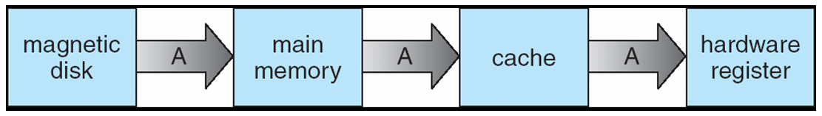
Migration of Integer A from Disk to Register
In hierarchical storage structure, the same data such as “A” may appear in different levels of the storage system (refer page 29).
The value of “A” becomes same only after the new value of “A” is written - internal register back to the magnetic disk.
In multiprocessor environment, each CPU’s own its local and it can execute value of “A” in parallel and must ensure an update of value of “A” immediately.
This situation is called cache coherency and is a hardware issue .
In distributed environment situation even more complex
  Several copies of the same file is kept on different computer
  Various solutions covered in Chapter 17

Slide 36
I/O Subsystem
One purpose of OS is to hides the functions of the hardware devices from the users
I/O subsystem responsible for
  Memory management of I/O including buffering (storing data temporarily while it is being transferred), caching (storing parts of data in faster storage for performance), spooling (the overlapping of output of one job with input of other jobs)
  General device-driver interface
  Drivers for specific hardware devices

Slide 37
10. TYPES OF OPERATING SYSTEMS
Early System
No operating system
  Machines run from a console with display lights, toggle switches, input device, and printer
Programmer acts as an operator
  Setup included loading the compiler, source program, saving compiled program, and loading and linking
One-user system
Serial processing
Weakness: CPU idle – waste CPU time

Slide 38
Five categories
of Operating Systems
Two distinguishing features
  Response time
  How data enters into the system
Batch
Interactive
Real-Time
Hybrid
Embedded

Slide 39
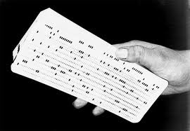
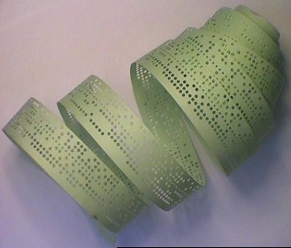
Batch Systems
  Input relied on punched cards or tape
  Same jobs are collected and executed as one batch
    Reduce setup time
  Resident monitor or batch monitor is introduced
    First rudimentary / basic operating system.
    initial control in monitor
    control transfers to job
    when job completes control transfers back to monitor
    Use automatic job sequencing – automatically transfers control from one job to another.

Slide 40
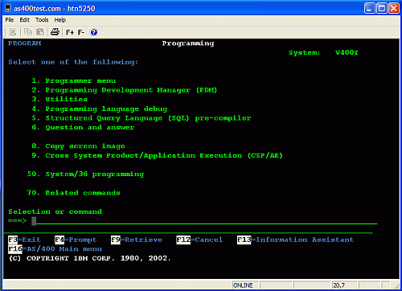
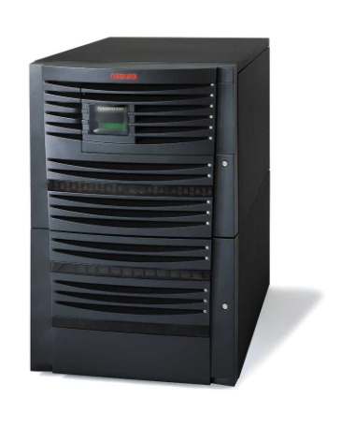

Interactive Systems
  Faster turnaround than batch systems
  Slower than real-time systems
  Introduced to provide fast turnaround when debugging programs
  Time-sharing software developed for operating system

Slide 41
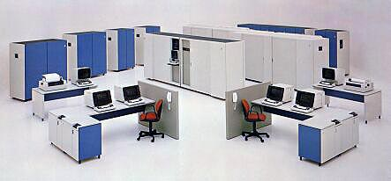
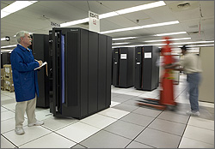
IBM
Mainframe
IBM Engineer Ed Horton records data from an IBM mainframe computer, which will replace many of the servers in the data center that stretches out behind him.
Another data center worker is preparing to remove the excess servers.

Slide 42

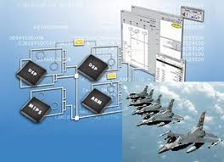
Real-time systems (RTOS)
  Reliability is key
  Fast and time limit sensitive
  Used in time-critical environments
    Space flights, airport traffic control, high-speed aircraft
    Industrial processes
    Sophisticated medical equipment
    Distribution of electricity
    Telephone switching
  Must be 100% responsive,
  100% of the time

Slide 43
Hybrid systems
  Combination of batch and interactive
  Appear to be interactive
    Users access system, fast responses
  Accept and run batch programs in the background
    Condition: when interactive load is light
  Take advantage from free time between high-low demand usage
  Many large computer system are hybrids

Slide 44
Embedded systems
  Computers placed inside other products
  Adds features and capabilities
  Operating system requirements
    Perform specific set of programs
    Not interchangeable among systems
    Small kernel and flexible function capabilities

Slide 45
11. COMPUTING ENVIRONMENTS
Traditional Computing
Mobile Computing
Distributed Systems
Virtualization

Slide 46
Computing Environments - Traditional
Stand-alone general purpose machines
But blurred as most systems interconnect with others (i.e., the Internet)
Portals provide web access to internal systems
Network computers (thin clients) are like Web terminals
Mobile computers interconnect via wireless networks
Networking becoming ubiquitous – even home systems use firewalls to protect home computers from Internet attacks

Slide 47
Computing Environments - Distributed
Collection of separate, possibly heterogeneous, systems networked together
  Network is a communications path, TCP/IP most common
    Local Area Network (LAN)
    Wide Area Network (WAN)
    Metropolitan Area Network (MAN)
    Personal Area Network (PAN)
Network Operating System provides features to allow sharing of data between systems across a network.
  Communication scheme allows systems to exchange messages
  Illusion of a single system

Slide 48
Computing Environments - Mobile
Handheld smartphones, tablets, etc
What is the functional difference between them and a “traditional” laptop?
Extra features – more OS features (GPS -- Waze)
Allows new types of apps like augmented reality
Use IEEE 802.11 wireless, or cellular data networks for connectivity
Leaders are Apple iOS and Google Android

Slide 49
Virtualization
Allows operating systems to run applications within other OSes
  Vast and growing industry
Emulation used when the source CPU type is different from the target type (i.e., PowerPC to Intel x86)
  Generally slowest method
  When computer language not compiled to native code – Interpretation
Virtualization – OS natively compiled for CPU, running guest OSes also natively compiled
  Consider VMware running WinXP guests, each running applications, all on native WinXP host OS
  VMM (virtual machine Manager) provides virtualization services

Slide 50
Virtualization on Laptops and Desktops
A VMM allow the user to install multiple operating systems to run application written for operating systems other than the native host.
  Apple laptop running Mac OS X host Windows as a guest
  Developing apps for multiple OSes without having multiple systems
  Testing applications without having multiple systems
  Executing and managing compute environments within data centers

Slide 51
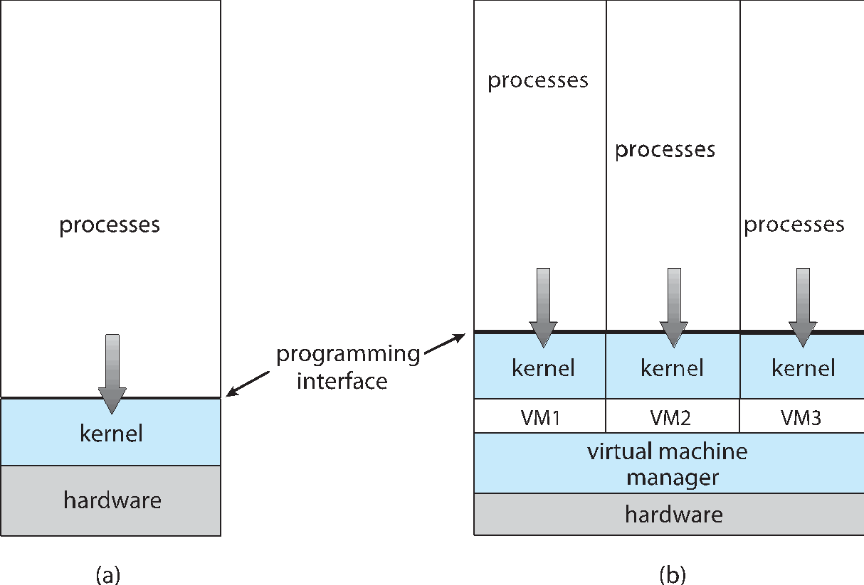
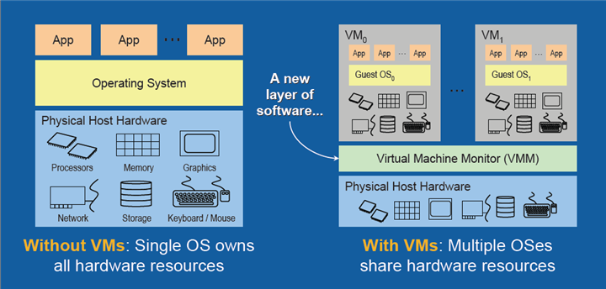
Virtualization Architecture Structure

Slide 52
End of Chapter 1

